Slide 1
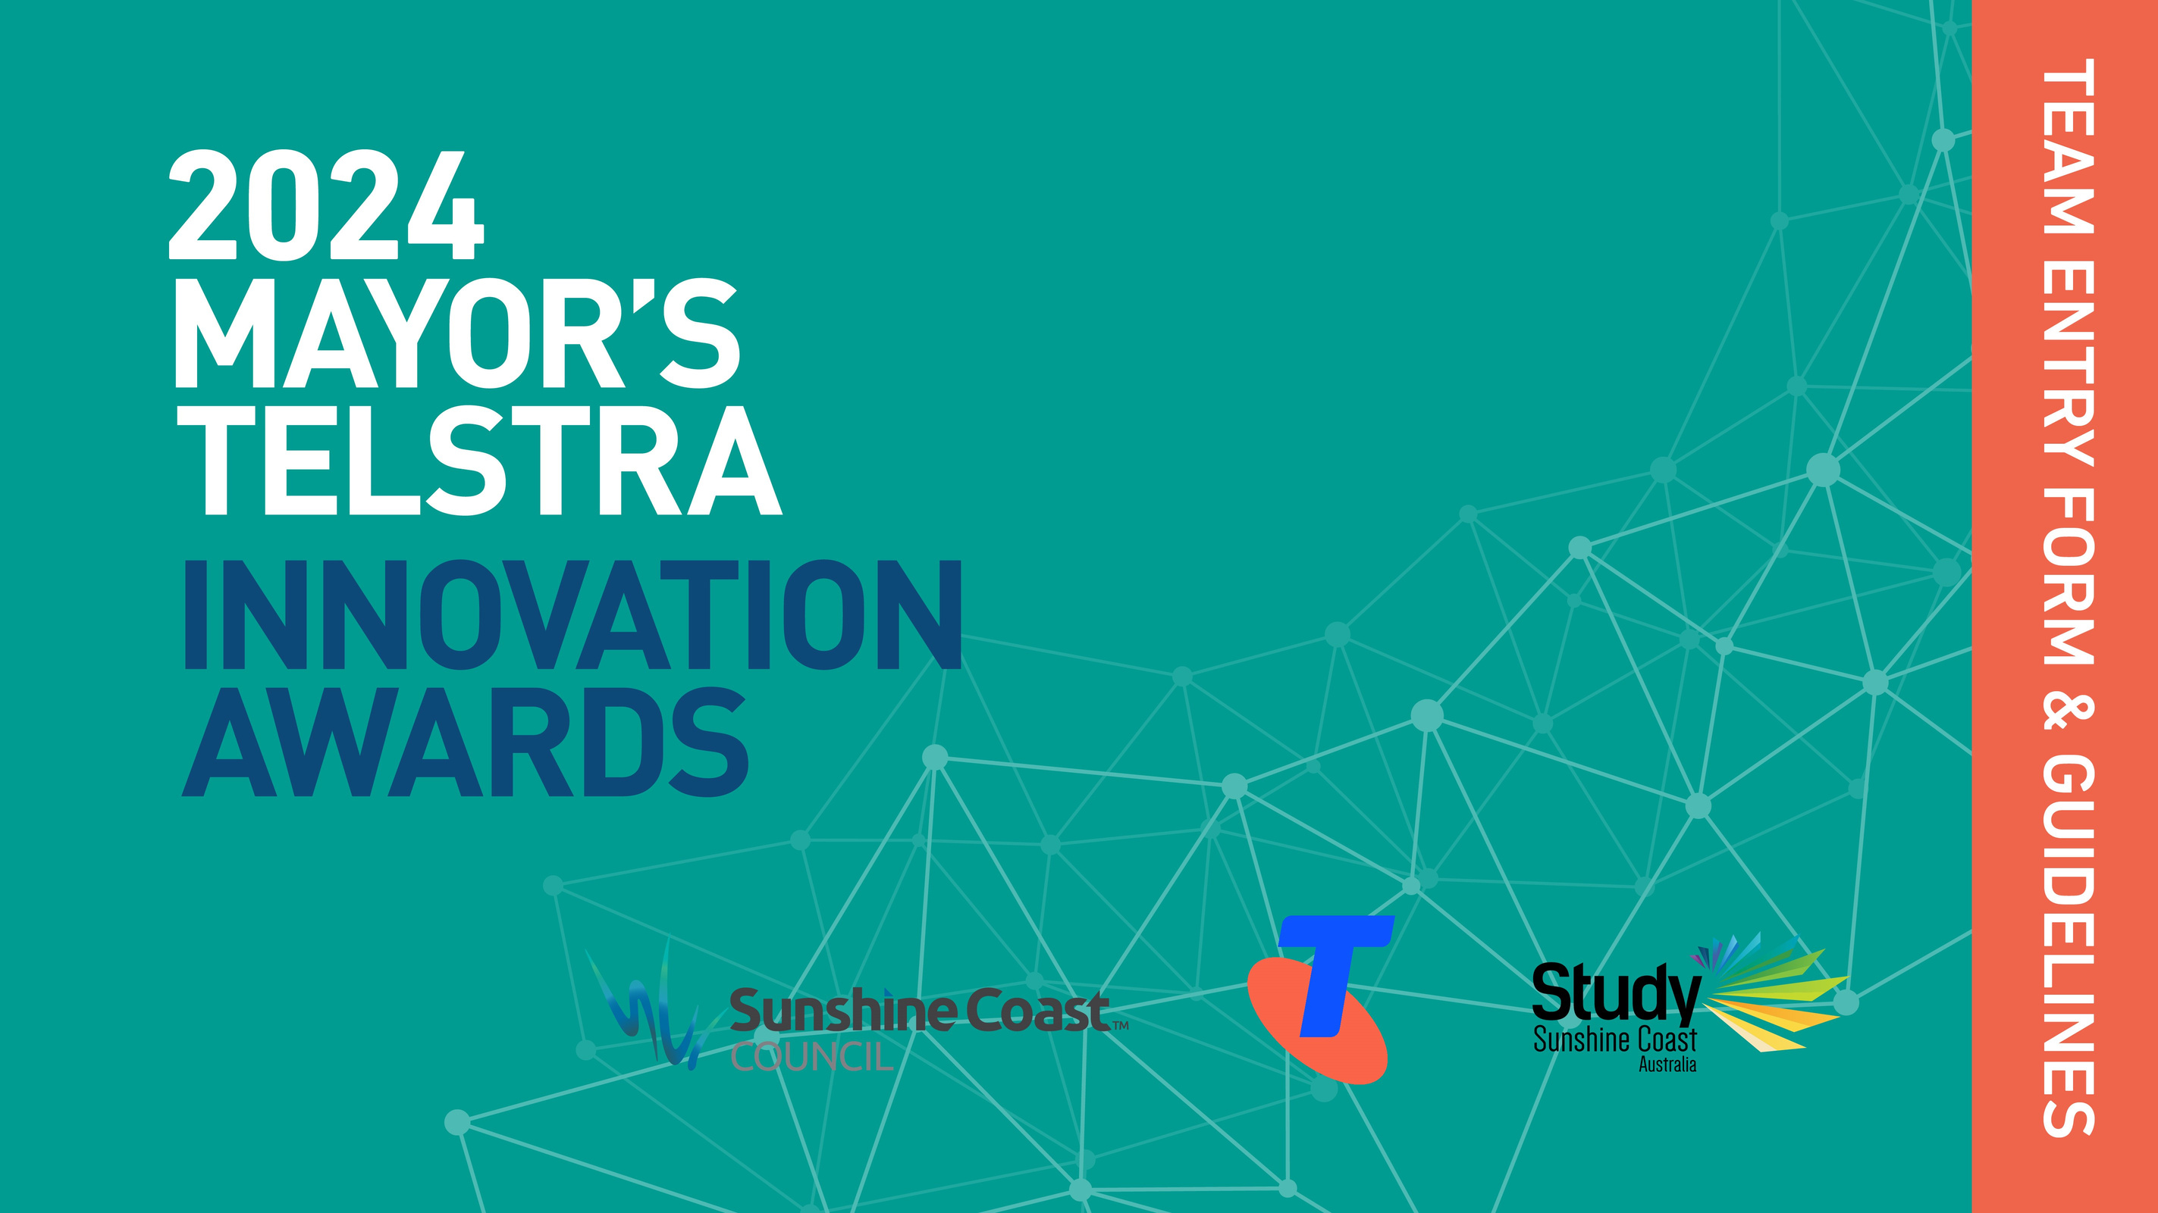

Slide 2

Instructions
    Do not insert additional slides!
    All text should be written in Arial 16pt
    You may delete all prompts shown in brackets prior to submission
    Your submission must not exceed 5MB in size

Slide 3
2024 Mayor’s Telstra Innovation Awards
Sunshine Coast Council is proud to partner with Telstra and Study Sunshine Coast to deliver the Mayor’s Telstra Innovation Awards 2024. The 2024 MTIA are open to all year 9 to 12 high school students within the Sunshine Coast Council local government area. Students can work in teams of up to three students and have the opportunity to create, innovate and collaborate by bringing their creative idea or business solution to life. There will be over $10,000 in prizes to share in including a personal mentor start-up incubator experience! Plus finalist teams have the opportunity to work with industry mentors and experts to further develop their idea and critical thinking.
“For students with a new idea wishing to learn about business creation and innovation, the Mayor's Telstra Innovation Awards is the perfect place to meet well-connected people willing to help you. The best part of the MTIA was learning about the processes of design and business while having mentors to guide and answer questions. The MTIA helped me confirm that I want to study in a field that allows me to help, think of, and design innovative solutions to problems.”
Charlie Bidgood | SolBot, 2023 Runner Up
For more information about the 2024 MTIA including entry criteria, key dates and critical information, please read the Student Handbook. This document provides student teams with further details about the team entry form and guidelines.

Slide 4


Entry Guidelines
Phase 1 Entries
Phase 1 is about student teams coming up with an innovative idea, creative concept or business solution or further developing an existing idea of concept. There is no restrictions on topics or themes.
This year we have provided an “Ideas Guide” with some potential entry themes if student teams are stuck for ideas or would like to pick a topic relevant to the local Sunshine Coast region.
Ideas Guide
In the following pages we have listed details about Sustainable Development Goals (SDGs) that relate to the Sunshine Coast region as part of the Sunshine Coast Council’s Regional Economic Development Strategy plan and are also a focus of the local business community. Student teams can use these as a guide to help you refine your innovative idea, creative concept or business solution or you can use your own topic.
BUSINESS
IDEA

Slide 5


Industry, Innovation and Infrastructure
SDG meaning: Build resilient infrastructure, promote inclusive and​ sustainable industrialization and foster innovation
Suggested topics:
  What business ideas, creative solutions and/or technology can leverage the underwater high speed internet cable – fastest internet from Australia to Asia here in Maroochydore
  Business ideas around accessibility infrastructure
  Ideas around transport solutions and mobility

Slide 6

Sustainable Cities and Communities
SDG meaning: Make cities and human settlements inclusive, safe, resilient and sustainable
Suggested topics:
  What business idea, creative solution and/or technology can leverage the SC’s UNESCO Biosphere title of sustainable communities living in union with their environment
  What environmental and local issues does Council need help with addressing, providing solutions for?
    or what does the community want to achieve and optimise by being a joint host city of the 2032 Olympic Games?
    or how do we maximise the Tourism opportunity?

Slide 7

Responsible Consumption
SDG meaning: Ensure sustainable consumption and production patterns
Suggested topics:
  What food production and or distribution ideas could be implemented to promote responsible consumption (ie. Biodegradable school canteen packaging)
  How can students look at business ideas that will complement the Blue Heart for sustainable food growth like seaweed
  How can tourism take full account of its current and future economic, social and environmental impacts, addressing the needs of visitors, the industry, the environment and host communities – while aiming to leave the area better off from visitation.
  What business solutions or technology can assist with Sustainable fashion and surf wear etc
  What innovative service or communication tool can help educate residents and businesses of responsible consumption and the circular economy?

Slide 8

Climate Action
SDG meaning: Take urgent action to combat climate change and its impacts
Suggested topics:
  How can students look at business ideas that will complement the Blue Heart project re: flood management / carbon sequestration https://www.sunshinecoast.qld.gov.au/blueheart
  What are the natural disaster issues facing our region (storms, floods, fires etc) and what business ideas could help manage these areas to support the community
  Ideas to help businesses prepare and recover from major weather events and climate change
  Ideas around carbon offset programs within local areas

Slide 9

Your Business Idea
You might have a business idea that has been in the back of your mind and you want to test it out through this program. Your business idea can be anything, so just put on your thinking cap and give it a go!
The best ideas are usually ones that impact you, someone close to you or our local region, and then can be scalable to a wider audience.

Slide 10
Team Entry Form
TEAM NAME: [add team name]
TEAM PARTICIPANTS:
1. Year Gender: M / F / Other
2. Year Gender: M / F / Other
3. Year Gender: M / F / Other
TEAM SCHOOL: [add school name]
SCHOOL COORDINATOR/TEACHER NAME: [add teacher’s name]
TEACHER EMAIL: [add teacher’s email]
TEACHER MOBILE NUMBER: [add teacher’s mobile number]

Slide 11
Concept
Tell us about your innovative idea, creative concept or business solution.
CONCEPT NAME:
CONCEPT SUMMARY:

Slide 12
Concept (continued)

Slide 13
Problem Solved
What is the problem/challenge you are solving?
[replace with your answer]

Slide 14
Problem Solved (continued)
If it addresses a current issue, SDG or problem facing the Sunshine Coast region, please list that here:
[replace with your answer]

Slide 15
How it Works
What technology or innovation will the idea or concept use?
Please describe this (Include any photos, graphics, 3D printed prototypes, drawings etc. to support the idea.
[replace with your answer]

Slide 16
How it Works (continued)

Slide 17
Target Audience
Who is your target (primary) audience that will benefit from this idea/solution and want to buy it?
Tell us about them.
[replace with your answer]

Slide 18
Competitors
Is there a product like this already in the market? Please list it/them here.
[replace with your answer]
If so, how is your product different?
[replace with your answer]

Slide 19
Competitors (continued)
List who you believe would be the main competitors for your product?
  [replace with your answer]
  [replace with your answer]
  [replace with your answer]
  [replace with your answer]
  [replace with your answer]

Slide 20
Channels
How will you reach your customers? What channels will you use to reach and promote your idea?
[replace with your answer]

Slide 21
Costs
Have you thought about costs for developing your product, building a prototype and marketing your product? How will you fund these areas?
[replace with your answer]

Slide 22
Parent Consent Form – Team Member 1
I consent for my child, _________________________________(print) to participate in the
Mayor’s Telstra Innovation Awards 2024 and the associated activities outlined in the School Handbook.
I have read, understood and on behalf of my child, agree to the terms and conditions of
the competition contained in the Mayor’s Telstra Innovation Awards 2024 School Handbook.
Parent/Guardian’s name___________________________________
Date ________________ Signature__________________________
INFORMATION COLLECTION NOTICE
Your personal information is being collected by Sunshine Coast Council and Study Sunshine Coast. The provision by you of this information is voluntary as is your child’s participation in the competition. The personal information collected will be used by Sunshine Coast Council and partners in this project to administer the competition in accordance with the terms and conditions contained in the Mayor’s Telstra Innovation Awards 2024 School Handbook. All personal information will be stored securely and except as provided for in those terms and conditions, will not be given to any other person or agency unless participants have given Sunshine Coast Council permission, or the Sunshine Coast Council is authorised or required by law.
The collection, use and disclosure of all personal information will be handled in accordance with the Information Privacy Act 2009 and Sunshine Coast Council privacy policy which is available at: https://www.sunshinecoast.qld.gov.au/council/contact-council/site-help/privacy

Slide 23
Parent Consent Form – Team Member 2
I consent for my child, _________________________________(print) to participate in the
Mayor’s Telstra Innovation Awards 2024 and the associated activities outlined in the School Handbook.
I have read, understood and on behalf of my child, agree to the terms and conditions of
the competition contained in the Mayor’s Telstra Innovation Awards 2024 School Handbook.
Parent/Guardian’s name___________________________________
Date ________________ Signature__________________________
INFORMATION COLLECTION NOTICE
Your personal information is being collected by Sunshine Coast Council and Study Sunshine Coast. The provision by you of this information is voluntary as is your child’s participation in the competition. The personal information collected will be used by Sunshine Coast Council and partners in this project to administer the competition in accordance with the terms and conditions contained in the Mayor’s Telstra Innovation Awards 2024 School Handbook. All personal information will be stored securely and except as provided for in those terms and conditions, will not be given to any other person or agency unless participants have given Sunshine Coast Council permission, or the Sunshine Coast Council is authorised or required by law.
The collection, use and disclosure of all personal information will be handled in accordance with the Information Privacy Act 2009 and Sunshine Coast Council privacy policy which is available at: https://www.sunshinecoast.qld.gov.au/council/contact-council/site-help/privacy

Slide 24
Parent Consent Form – Team Member 3
I consent for my child, _________________________________(print) to participate in the
Mayor’s Telstra Innovation Awards 2024 and the associated activities outlined in the School Handbook.
I have read, understood and on behalf of my child, agree to the terms and conditions of
the competition contained in the Mayor’s Telstra Innovation Awards 2024 School Handbook.
Parent/Guardian’s name___________________________________
Date ________________ Signature__________________________
INFORMATION COLLECTION NOTICE
Your personal information is being collected by Sunshine Coast Council and Study Sunshine Coast. The provision by you of this information is voluntary as is your child’s participation in the competition. The personal information collected will be used by Sunshine Coast Council and partners in this project to administer the competition in accordance with the terms and conditions contained in the Mayor’s Telstra Innovation Awards 2024 School Handbook. All personal information will be stored securely and except as provided for in those terms and conditions, will not be given to any other person or agency unless participants have given Sunshine Coast Council permission, or the Sunshine Coast Council is authorised or required by law.
The collection, use and disclosure of all personal information will be handled in accordance with the Information Privacy Act 2009 and Sunshine Coast Council privacy policy which is available at: https://www.sunshinecoast.qld.gov.au/council/contact-council/site-help/privacy

Slide 25
Submission
Once you have completed all questions, along with the signed parental consent form for every team member, please submit your entry no later than by:
Wednesday 17ᵗʰ April 2024 by 11:59pm
Please email to: shannara@studysunshinecoast.com.au
By submitting your entry you confirm that all details submitted are true and you can commit to attending all of the dates listed below should you become a finalist:
Mentoring Sessions 4pm - 7pm | Wednesday 1 May 2024 and Wednesday 15ᵗʰ May 2024
Phase 2 Entries Due by Wednesday 5ᵗʰ June 2024
Awards & Pitch Night 4.30pm - 7.30pm | Thursday 20ᵗʰ June 2024
For more information go to - studysunshinecoast.com.au/mtia2024/
st

Slide 26
